Slide 1
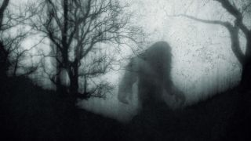
TEAM 3: HARRY & THE HENDERSONS
DAN DAVIES, STEFANIE GAGNON, CHRIS PARTEE, KHANH LE

Slide 2
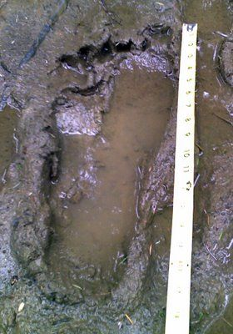
DATA OVERVIEW

Slide 3
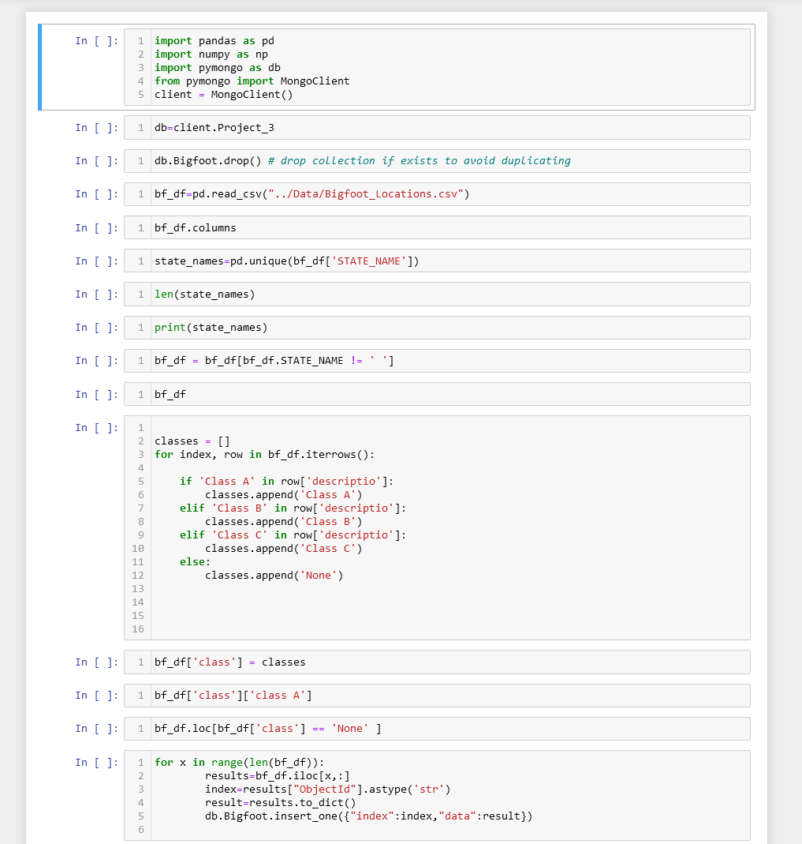
DATA OVERVIEW
The data was derived from data provided by the Bigfoot Field Research Organization (BFRO), DataWorld.
BFRO is an organization dedicated to investigating the bigfoot / sasquatch mystery.
Incident information is collected by a Sighting Report Form on BFROs site that is saved to a server.
Tools Used
We used an ETL script in dealing with our data.
Jupyter Notebook/Python - To clean up CSV to be used and uploaded, also to scrap a site of photos and their descriptions.
MongoDB - data was imported to a DataBase for our dashboard to use

Slide 4
Visualize dataset:
Get the data:
The BFRO provides sighting data in numbers of different formats. Use the CSV dataset to convert database.
The online article “The 10 Most Convincing Bigfoot Sightings” from The Outside journalism website.
Import & Visualize the data:
Create a map using Leaflet that plots the sightings from the database based on their longitude and latitude, including 3 base maps: Satellite, Street, Topographical.
The data markers reflect the numbers of sightings.
The popups provide detail information about the sighting when a marker is clicked.
Plotting bar chart and line chart show sighting distribution by class and by year.

Slide 5
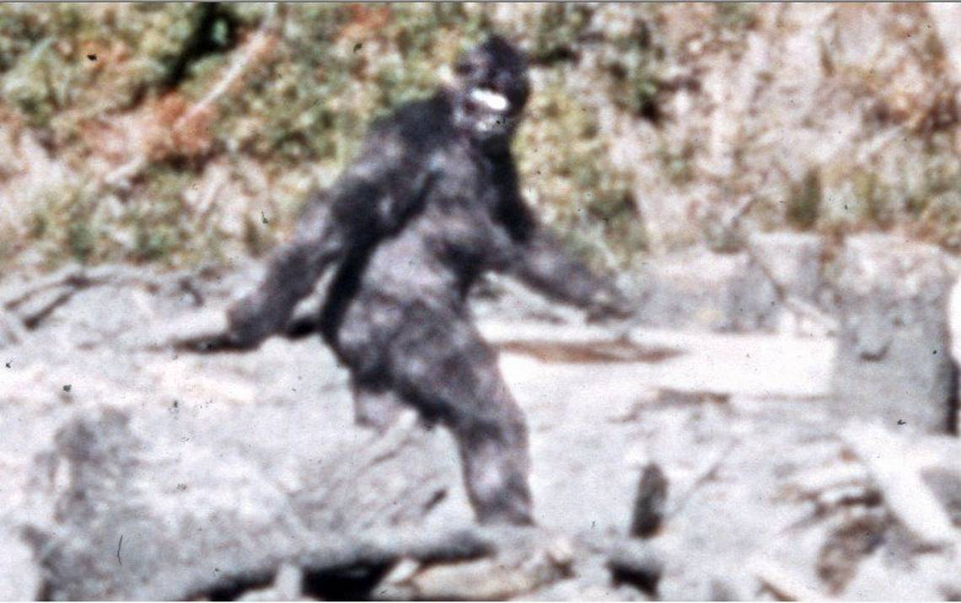
DATA ANALYSIS AND VISUALIZATIONS

Slide 6
What is in the data?
CSV file contains Latitude and Longitude, a description and the state of each incident
Classes were extracted from the description during ETL phase
Types of Classes:
Class A: reports involve clear sightings in circumstances where misinterpretation or misidentification of other animals can be ruled out with greater confidence.
Class B: incidents where a possible sasquatch was observed at a great distance or in poor lighting conditions and incidents in any other circumstance that did not afford a clear view of the subject such as sounds or indirect events.
Class C: most second-hand reports, or third-party reports, or stories with untraceable sources.
Web Scraping:
10 photos and descriptions of convincing Bigfoot sightings.

Slide 7
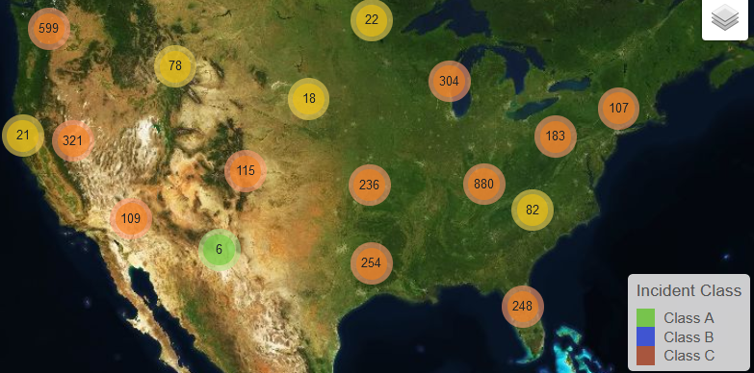
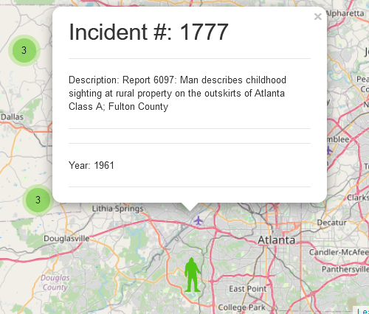
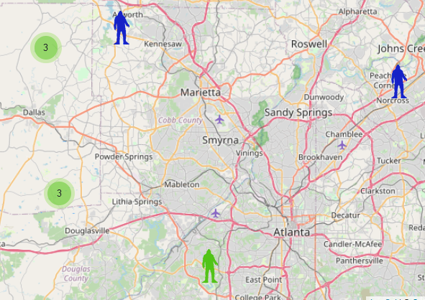
Visualizations:

Slide 8
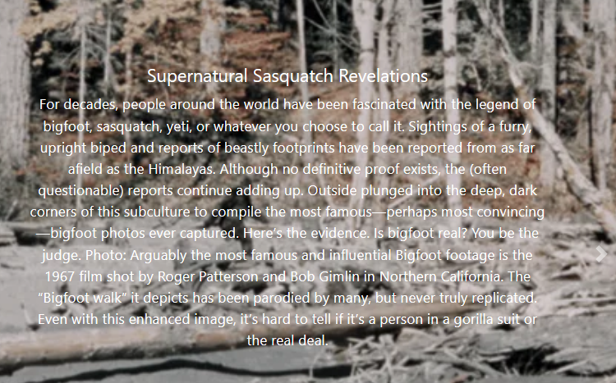
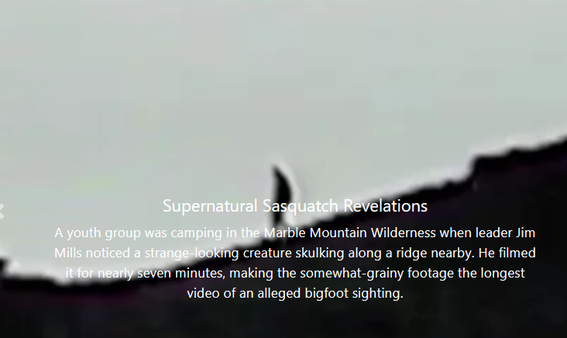
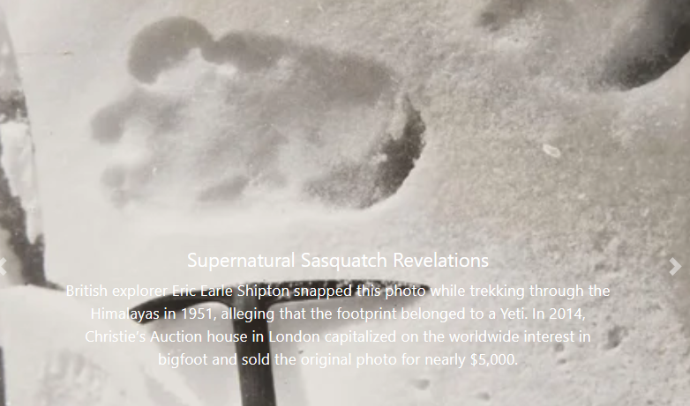
DATA ANALYSIS AND VISUALIZATIONS

Slide 9
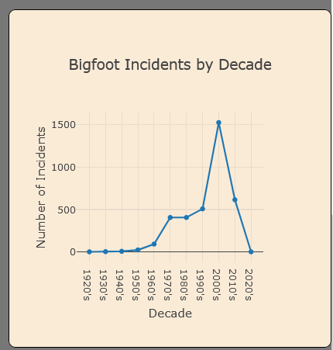
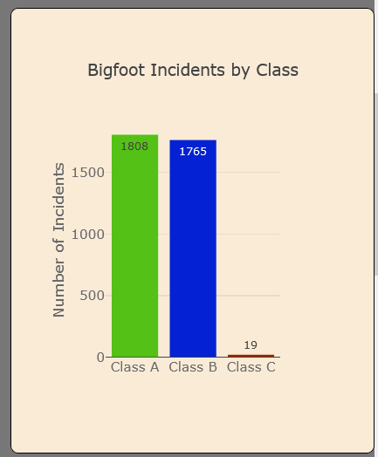
DATA ANALYSIS AND VISUALIZATIONS

Slide 10
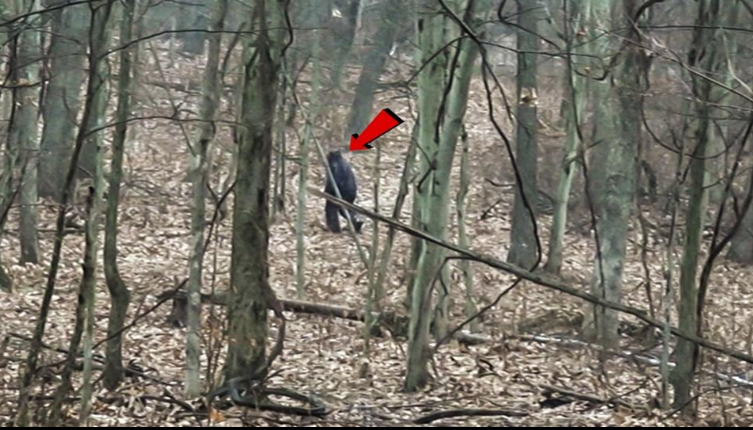
FINDINGS

Slide 11
FINDINGS
Which region have a higher density of sasquatch incidents.
Distribution of bigfoot sightings by year
Distribution of bigfoot sightings by class.

Slide 12
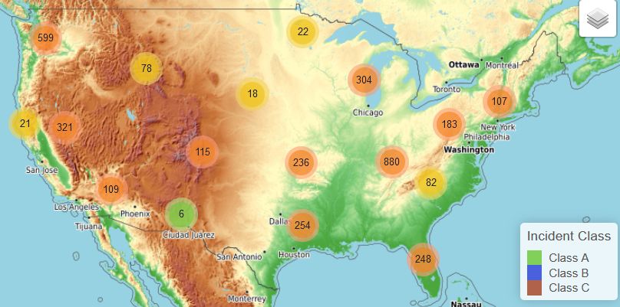
Regions with high density of Bigfoot incidents

Slide 14
QUESTIONS FOR FURTHER EXPLORATION
Using an API to compare to sighting locations to see where Bigfoot shops
create a story plot
comparing against regional resources: vegetation, rainfall, etc.

Slide 15
REFERENCES:
https://hub.arcgis.com/datasets/TrainingServices::-bigfoot-sightings/explore?location=27.848424%2C-103.774481%2C4.00
https://data.world/timothyrenner/bfro-sightings-data
https://cdn.pixabay.com/photo/2022/01/14/04/02/bigfoot-6936421__340.png
https://www.outsideonline.com/gallery/10-most-convincing-bigfoot-sightings/
Scraping bigfoot image from https://cdn.pixabay.com/
Scraping news and images from www.outsideonline.com

Slide 16
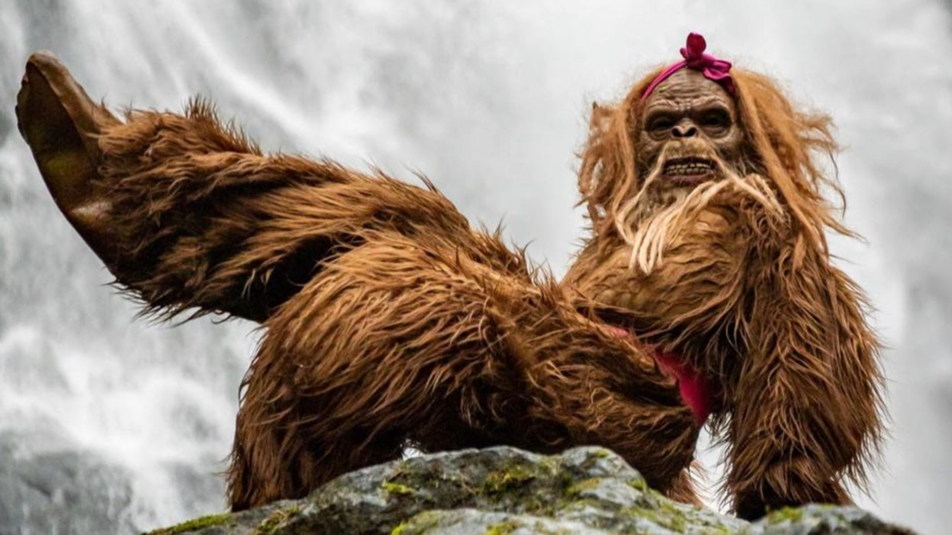
Where do you think you can see BIGFOOT?
… in your BACKYARD?

